Slide 1
Software Engineering
COMP 201
Lecturer: Sebastian Coope
Ashton Building, Room G.18
E-mail: coopes@liverpool.ac.uk
COMP 201 web-page:
http://www.csc.liv.ac.uk/~coopes/comp201
Lecture 3 – Software Processes

Slide 2
This lecture will look at
Requirements engineering and specification
Software design
Programming, testing and debugging
Software Evolution

Slide 3
Software Specification
Software Specification: The process of establishing what services are required and the constraints on the system’s operation and development
Requirements Engineering Process
  Feasibility study
  Requirements elicitation and analysis
  Requirements specification
  Requirements validation

Slide 4
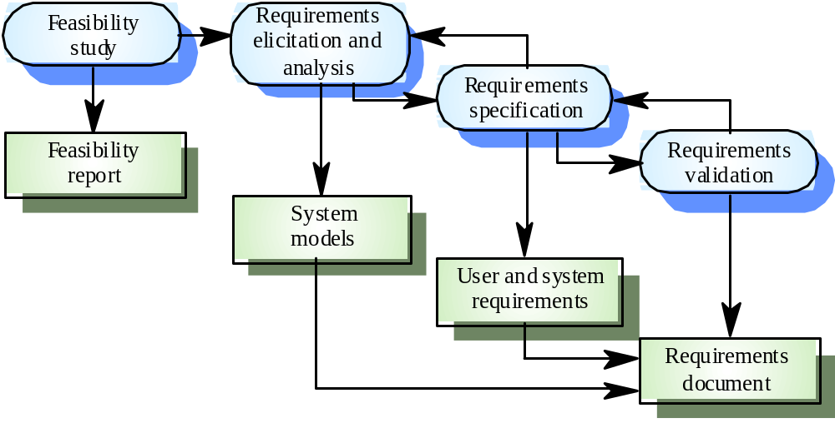
The Requirements Engineering Process

Slide 5
Software Design and Implementation
The process of converting the system specification into an executable system
Software design
  Design a software structure that realises the specification
  Tasks .. Design database, website design, data structures, communications protocols
Implementation
  Translate this structure into an executable program
The activities of design and implementation are closely related and may be inter-leaved

Slide 6
Design Process Activities
Architectural design (separate web service modules)
  The sub-systems making up the system and their relationships are identified and documented.
Abstract specification
  For each sub-system, an abstract specification of its operational constraints and services is produced.
Interface design
  For each sub-system, an unambiguous interface with other sub-systems is designed and documented
    Formal specification may be used in this stage (we study this later)

Slide 7
Design Process Activities
Component design
  Services are allocated to components and the interfaces of these components are designed
Data structure design
  The data structures used in the system implementation are designed in detail and specified
Algorithm design
  The algorithms used in components to provide services are designed and specified

Slide 8
An Example System
Consider the scenario of developing a Coffee/drinks machine software
What are the major sub-systems?
  Graphical display, cash handling, accounting, safety system, recipe handling, stock control
How may we define an abstract specification for each? How do the different sub-systems interact?
Can you define specifications for components/data structures and algorithms for one of the sub-systems?

Slide 9
Cash handling
Cash handling
Abstract specification
  Registers entry of new coins with updated balance
  Handles return of change
  Can be interfaced to wide range of coin handling mechanisms
  Interfaces with note acceptor hardware
  Locks coin mechanism when machine is out of order

Slide 10
Design Methods
Design (structured) methods are systematic approaches to developing a software design
The design is usually documented as a set of graphical models
Possible models (we study these in detail in later lectures)
  Data-flow model
  Entity-relation-attribute model (data base or class design)
  Structural model
  Object models
  A state transition model showing system states and triggers

Slide 11
Programming and Debugging
Programming and Debugging consist of translating a design into a program and removing errors from that program
Programming is usually personal activity - there is no generic programming process, but there are good programming practices and organisational standards to be followed.
Programmers carry out some program testing to discover faults in the program and remove these faults in the debugging process

Slide 12
Good programming is iterative
Write a very small piece of code
Determine it works (test it)
Archive it
Add little bit to code, test it
Archive it
Add little bit to code, test it
Etc. etc.

Slide 13
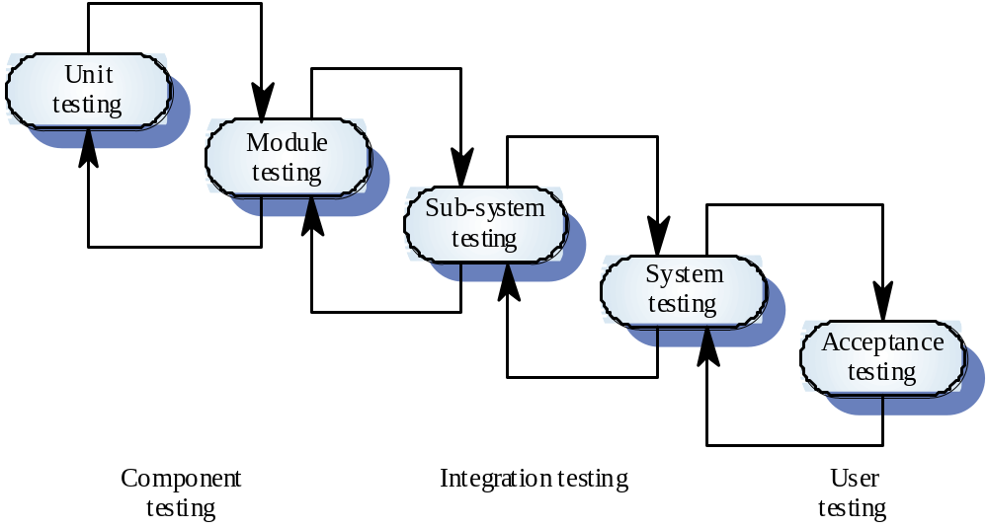
The Testing Process

Slide 14
Testing Stages
Unit testing
  Individual components are tested
Module testing
  Related collections of dependent components are tested
Sub-system testing (merges with system testing)
  Modules are integrated into sub-systems and tested. The focus here should be on interface testing
System testing
  Testing of the system as a whole. Testing of emergent properties
Acceptance testing
  Testing with customer data to check that it is acceptable

Slide 15
Testing mapped to OO programming
Unit testing (class/method level)
  Testing an individual classes methods
Module testing (interleaved with unit testing)
  Testing classes which integrate with other classes
Sub-system testing
  A number of classes tested which produce a given service (example card payment services, SMS sending services)
  Organised as package or JAR library
System test
  Test whole system

Slide 16
Next Lecture
Requirements engineering is the process of developing a software specification
In the next lecture we will be looking at
REQUIREMENTS
This will be part of coursework 1

